Slide 1
PYGAME PROJECT
HANGMAN GAME
Archana V
Ratna Prabha N
Trishala AG

Slide 2
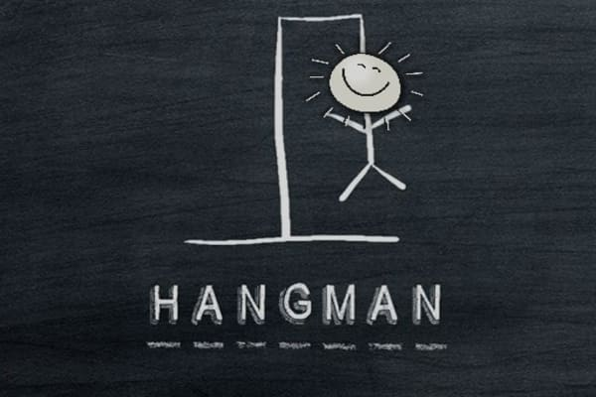
About Hangman
Hangman is a paper and pencil guessing game played between two or more players.
One player thinks of a word, phrase or sentence and the other(s) tries to guess it by suggesting letters within a certain number of guesses.
“SPACEMAN” is an alternative to hangman.
It is familiar with how hangman is played.

Slide 3
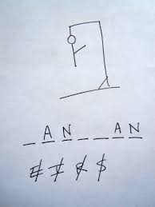
An example game of hangman in progress.
The underlined letters appear in the word in their correct places,while the crossed-out letters do not appear,and each crossed-out letter corresponds to one part of the drawing.
In this case, the secret word is “HANGMAN”
EXAMPLE

Slide 4
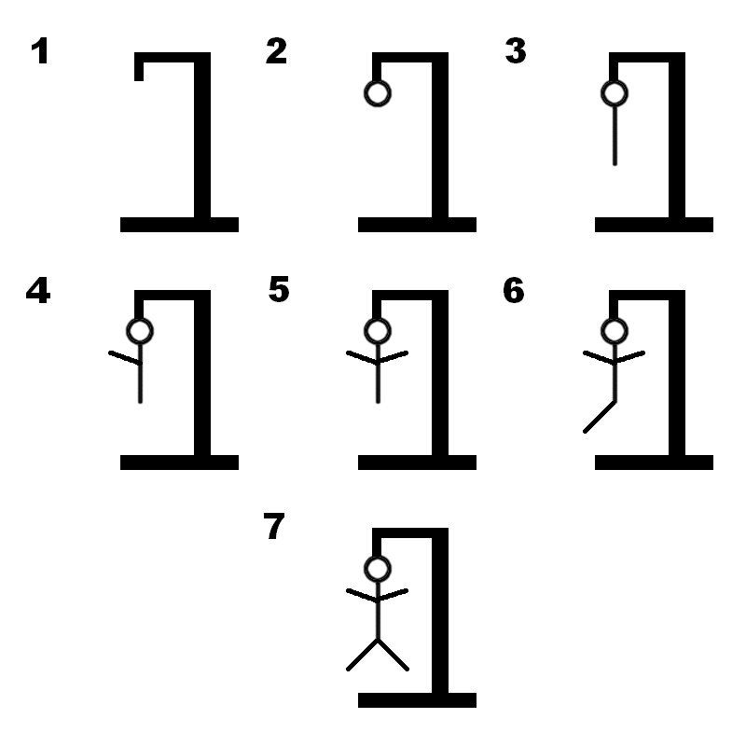
We are representing the state of the Hangman in the Game by using 7 images.
When the Hangman Game will start, it display the 1st image.
The user will have the right to make 6 errors. Beyond this limit, the game will be over.

Slide 5
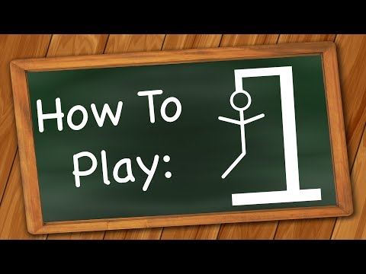
HOW TO PLAY?

Slide 6
Our code will generate a word which has to be guessed by the player. So,at the output screen will exist marked out blanks (short lines) for each letter of a word.Then the player will guess a letter. If that letter is in the word(s) then the project will write the letter at everyplace it appears, and cross out that letter in the alphabet. If the letter isn't in the word then we cross out the lifelines (which are usually a finite no. of chances) from the list. The player will continue guessing the letters until he can either solve the word (or phrase) or he will end up losing all the lifelines and he will be declared a LOSER.
So, it is basically a TWO PLAYER game.But in my project a single player plays the game and the rules are strictly followed by the programme.

Slide 7
Repl link
Link for python coding for the hangman project in repl.it
https://replit.com/@Archana26/hangmanproject#main.py

Slide 8
Thank You!

